Slide 1
Currencies

Slide 2
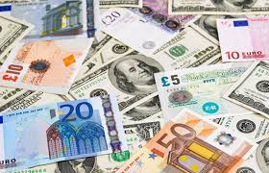

Overview
History of Currencies
Pre-coins
Coins
Paper
Digital currencies
Digital
Virtual
Crypto

Slide 3
Currency – live blood of our economy
We use currency to buy good and services.
We use currency to save and invest.
We may for the transactions using
physical money (notes and coins) or
Electronically (cards, phone)
Currency is a unit of purchasing power
"­W­e­ invented money and we use it, yet we cannot...understand its laws or control its actions. It has a life of its own." - Lionel Trilling, literary critic

Slide 4
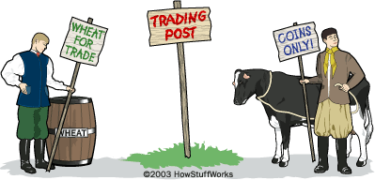
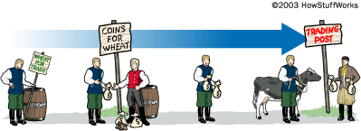
Exchange Pre-currency
Pre-currency we had to exchange good for services.
Bread for meat, carpentry for flour, cow for two goats, etc.
What is the difficulty with this system?
Difficult if people do not at the same time need your product/service in exchange for their product or service.
Currency can help with this process (transaction)
The person purchasing can give currency in exchange for the product the service
The person receiving the currency does not have to spend it with the person paying for the goods/services
Easier to find customers,
Easier to carry around.

Slide 5
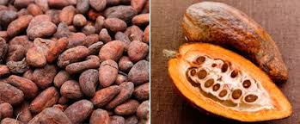
Commodity Currency
Commodity Currencies middle way between exchange and what we know as currencies.
The thing is not only a placeholder for the exchange but also has an inherent value itself.
Aztecs used Cocoa beans as a tribal tax, highly valued.
Cocoa owes its value to the difficulties inherent in growing the cacao tree and producing cocoa beans.
Its low yield in particular made it an expensive commodity.
However, it could not fulfil all the functions of a monetary instrument. It served as a means of exchange but not as a standard of value.
For that, the Maya and the Aztecs instead tended to use large white cotton cloths (quachtli) representing a given sum of work. Cocoa beans, on the other hand, could be divided up at will.
Like any well-trusted currency, cocoa beans were also the target of counterfeiting in various forms. For instance, forgers emptied the precious bean and then filled it up with mud to give it a weight equivalent to one cocoa bean.
Notes:
Cocoa owes its value to the difficulties inherent in growing the cacao tree and producing cocoa beans. Its low yield in particular made it an expensive commodity.
Cocoa was one of the best examples among the more primitive means of payment. However, it could not fulfil all the functions of a monetary instrument. It served as a means of exchange but not as a standard of value. For that, the Maya and the Aztecs instead tended to use large white cotton cloths (quachtli) representing a given sum of work. Cocoa beans, on the other hand, could be divided up at will.
Like any well-trusted currency, cocoa beans were also the target of counterfeiting in various forms. For instance, forgers emptied the precious bean and then filled it up with mud to give it a weight equivalent to one cocoa bean. https://www.nbbmuseum.be/en/2013/03/kakao.htm
If a herder from the country wants to trade with a city dweller, his cattle aren't going to have much value. European explorers dumped entire boatloads of cacao beans because they didn't value them like the Aztecs did.

Slide 6
Commodity Currency
Commodity Currencies middle way between exchange and what we know as currencies.
Also cattle were used as commodity currency in agrarian societies. Fee - comes from the German word for cattle, vieh
If a herder from the country wants to trade with a city dweller, his cattle aren't going to have much value.
European explorers dumped entire boatloads of cacao beans because they didn't value them like the Aztecs did.
Commodity Currency operate well as a medium of trade in a society,
Hard to transport and can perish
Do not work outside the bounders of the society they are used in
Notes:
Cocoa owes its value to the difficulties inherent in growing the cacao tree and producing cocoa beans. Its low yield in particular made it an expensive commodity.
Cocoa was one of the best examples among the more primitive means of payment. However, it could not fulfil all the functions of a monetary instrument. It served as a means of exchange but not as a standard of value. For that, the Maya and the Aztecs instead tended to use large white cotton cloths (quachtli) representing a given sum of work. Cocoa beans, on the other hand, could be divided up at will.
Like any well-trusted currency, cocoa beans were also the target of counterfeiting in various forms. For instance, forgers emptied the precious bean and then filled it up with mud to give it a weight equivalent to one cocoa bean. https://www.nbbmuseum.be/en/2013/03/kakao.htm
If a herder from the country wants to trade with a city dweller, his cattle aren't going to have much value. European explorers dumped entire boatloads of cacao beans because they didn't value them like the Aztecs did.

Slide 7
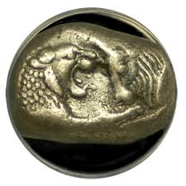
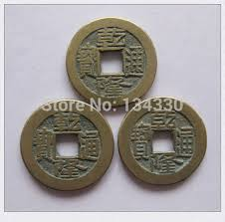
Currency -coins
2500BC the Egyptians used metal rings to say what value of something was, but not actually use them in the exchange.
First minted coins came from Lydia (in present day Turkey)
small silver or gold ingots stamped with an imperial emblem,
Values set by the governing authority.
Spread to the Greeks and eventually to the Romans.
China also used commodity currencies in the form of tools, with a hole to hang them a piece of string.
These became rounder and form what we call coins.

Slide 8
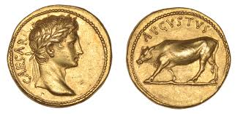
Currency:- coins
Now their was coins that the government minted and controlled the value.
When the U.S. Mint creates coins, seigniorage -- the difference between the value of money and the cost of its production -- means instant profit.
According to the U.S. Mint, it only takes a few cents to mint a quarter, but the quarter is instantly worth 25 cents. That difference is the money that keeps the mint running.
They also controlled the realised in to the market place
manipulate the money supply,
reduce the amount of precious metal in coins to produce more coins for the same tonne of gold.
The instable Roman economy was a factor in it fall (476 AD).
In Europe this caused a mistrust of coins and for hundreds of years coins where not use (until the Renaissance, 14th Century).
Notes:
When the U.S. Mint creates coins, seigniorage -- the difference between the value of money and the cost of its production -- means instant profit. According to the U.S. Mint, it only takes a few cents to mint a quarter, but the quarter is instantly worth 25 cents. That difference is the money that keeps the mint running.

Slide 9
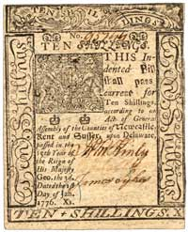
Currencies- paper
First paper money was in the Tang Dynasty - 618-907 AD
used stag skins, bark, or parchment marked with the imperial seal as "bills of payment."
The penalty for counterfeiting was death.
In Europe the distrust meant paper was not generally accepted used until 1700s
The started with goldsmiths giving bills of receipt for the their gold.
This representative money, can be exchanged for a fixed amount of gold
A Swedish bank issued paper money in 1661, but they flooded the market with it, and it lost its value.
Notes:
leather money was used around 1100 in the EU, but only as a temporary substitute when silver supplies ran low.

Slide 10
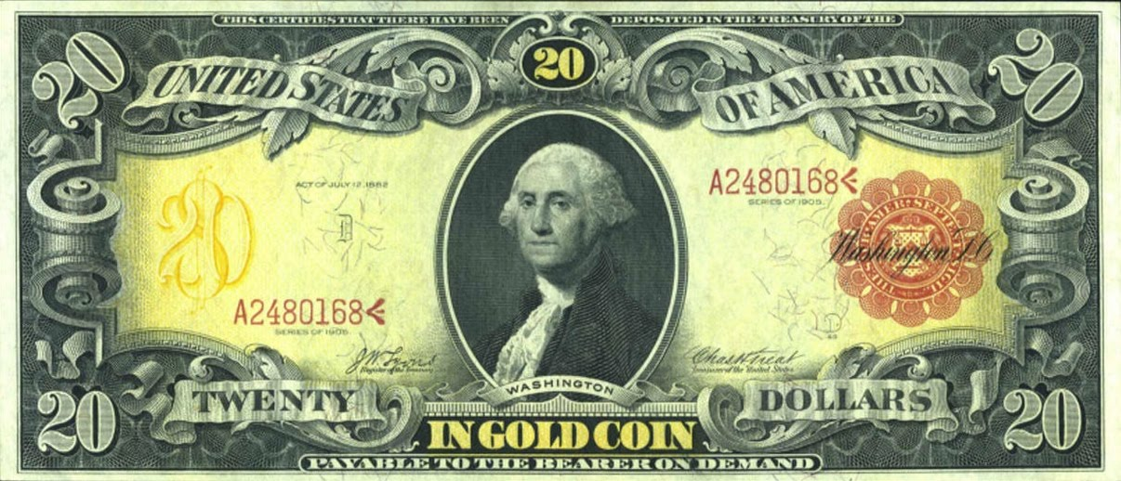
Gold Backed currencies.
The issuing institutions of the currencies actually promised that the institution would pay the holder of the bill an amount of gold, when ever they wanted.
All currencies were backed by the gold standard until 1971
Called representative currencies
However could lead to a run on a national gold supply

Slide 11
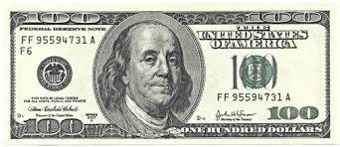
Fiat Money
Fiat Money
Not backed by anything
Government declare as legal tender
Holds its value that people think other people will accept it, not on the material it is made of or referred to.
Not a fixed or scare recourse, but has a monetary unit.
Perception of Value
money is based on our perception, announcement by government can change the perception
People can lose faith in these currencies - Zimbabwe
Stock Market is another currency system.

Slide 12
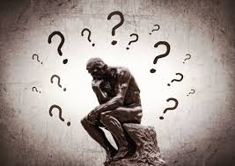
Question
What can go wrong with Fiat Currencies

Slide 13
When it goes wrong
Economic conditions under the country's president, Robert Mugabe, were deteriorating in the 1990s, with a low standard of living, high unemployment, lower wages and inflation as high as 17 percent at one point.
In 2000, Mugabe began a series of "land reform programs," which sought to take farms from the white minority and hand them over to black residents.
Unfortunately, the farms were given to people who lacked experience in agriculture. This hit the country's export revenue as these farms started to fail.
In order to respond to the shortfall, the country's central bank started to print money at a much more rapid pace, instead of trying to implement more traditional forms of economic policy.
The money printed was used to help pay off the country's debts, and offset higher prices set off by the agricultural industry's failure.
As the economy continued to fall, inflation hit record rates, at one point hitting between 230 and 500 billion percent in 2008.
Prices were rising rapidly and consumers were forced to carry bags of money just to purchase basic staples.
This meant the value of the Zimbabwe dollar began to crumble.
At the height of the decline, 1 trillion Zimbabwe dollars were worth about $0.40 USD. According to an NBC report, 100 trillion Zimbabwe dollar notes were the last banknote to be produced, and paid for a one-week commute to work.
Notes:
Economic conditions under the country's president, Robert Mugabe, were deteriorating in the 1990s, with a low standard of living, high unemployment, lower wages and inflation as high as 17 percent at one point. In 2000, Mugabe began a series of "land reform programs," which sought to take farms from the white minority and hand them over to black residents. Unfortunately, the farms were given to people who lacked experience in agriculture. This hit the country's export revenue as these farms started to fail. In order to respond to the shortfall, the country's central bank started to print money at a much more rapid pace, instead of trying to implement more traditional forms of economic policy. The money printed was used to help pay off the country's debts, and offset higher prices set off by the agricultural industry's failure.
As the economy continued to fall, inflation hit record rates, at one point hitting between 230 and 500 billion percent in 2008. Prices were rising rapidly and consumers were forced to carry bags of money just to purchase basic staples. This meant the value of the Zimbabwe dollar began to crumble. At the height of the decline, 1 trillion Zimbabwe dollars were worth about $0.40 USD. According to an NBC report, 100 trillion Zimbabwe dollar notes were the last banknote to be produced, and paid for a one-week commute to work.

Slide 14
Non-Physical Money
In 1871 the Western Union successfully transferred money
After 1945, banks would put daily transaction on to magnet tape and taken to regional federal reserve bank.
Modern bank now
The first credit card was the Diners Club card in 1951transfer billions of dollar a day.
Now we have internet banking, chip and pin, and nearfield payments

Slide 15
Exchange-Rate
Trade is now global, so we need to be able to work in different currencies.
We may set a firm exchange rate by pegging our currency against the dollar or Euro.
This is ensured by the central bank buying and seedling to preserve the local exchange rate.
Aim is to give stability
Can have big problems - Black Wednesday
Alternative is to let the currency float
Then the rules of supply and demand come in.

Slide 16
Control
Supply and demand is the process will increase when there is demand
Prices decreases then there is less demand
This is also the case with money
Easy to see if it s commodity based, but just as real when the money is Fiat currency, and now also related to perception.
More money less demand by foreign investors, cheaper.
Inflation is a method of controlling the spending of money
More currency less buying power
Central bank take money out of circulation

Slide 17

Questions
Why would a cryptocurrency be any good?

Slide 18
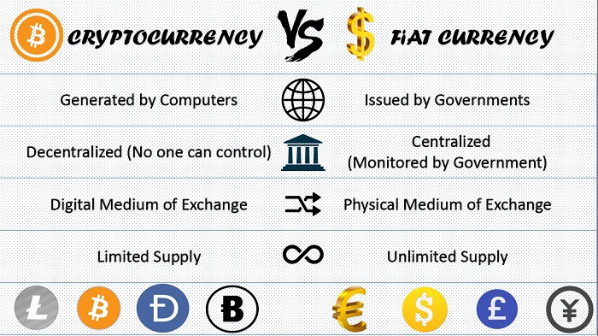

Slide 19
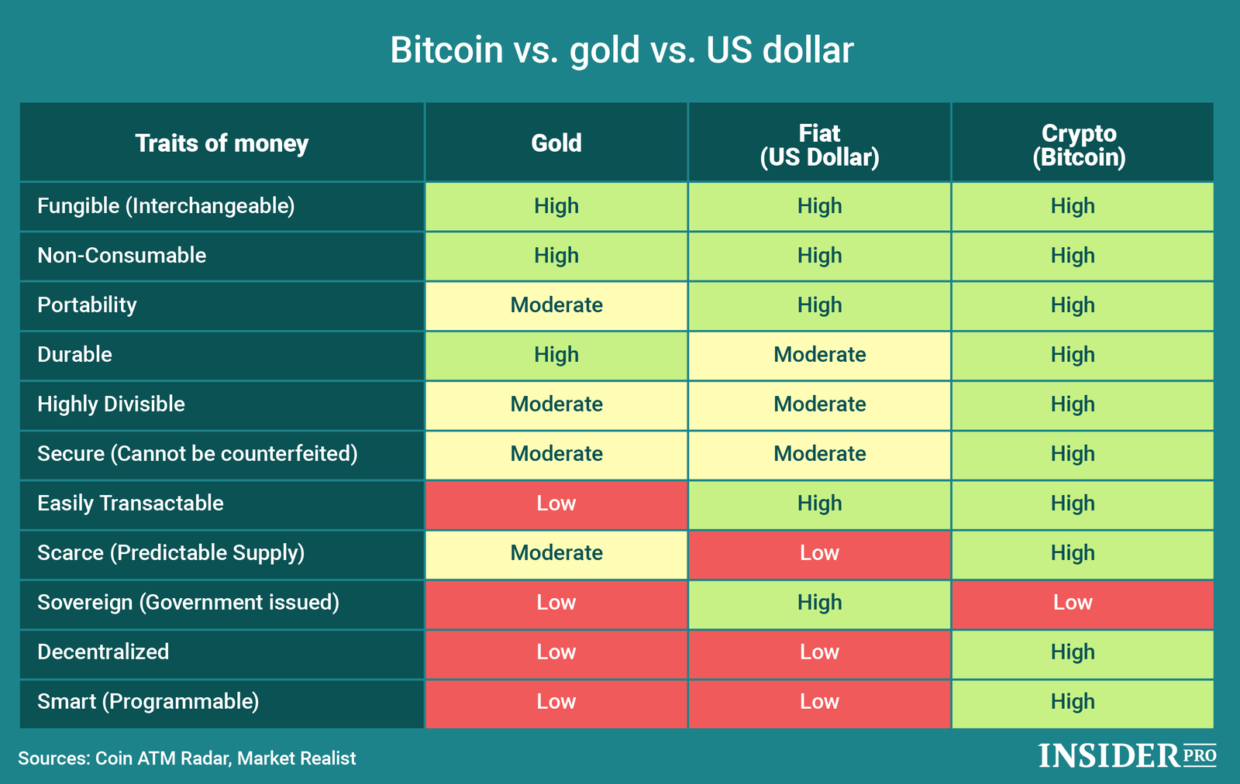

Slide 20
Digital Ledger

Slide 21
Ledgers
Ledgers have formed the backbone of our economies, since ancient times
They record contracts and transactions (payments), for buying and selling of goods, or the exchange of assets (property).
Originally records on stone, clay tablets, and papyrus and later paper –that led to ledger books supporting modern accounting.
Enabling trade, lending and the evolution of banking.
Now these records are in the digital realm, rooms of people replaced by digital computers which have made possible the complex global economic system we use today.

Slide 22
Distributed Ledgers Technology (DLT)
New revolution - ledgers are shifting to a global decentralized network which is cryptographically secured, and fast.
Forming a trusted system that is based on cryptography not people or a centralized authority.
Accessed using keys and cryptographic signatures
Any changes made to the ledger are reflected and copied to all participants in a matter of seconds or minutes, each participant owns an identical copy.
These networks provide a full audit trail of information history available at all times.
DLTs can be used for the recording, tracking, monitoring, and transacting of all forms of assets, all asset registries, inventories, and exchanges, including every area of economics, finance, and money; physical assets such as cars and houses; and intangible assets such as votes, ideas, health data, reputation etc.
Notes:
information history, which can be traced back to the moment when a piece of information was created
In this case, the blockchain can serve as the public records repository for whole societies, including the registry of all documents, events, identities, and assets. In this system, all property could become smart property;
this is the notion of encoding every asset to the blockchain with a unique identifier such that the asset can be tracked, controlled, and exchanged on the blockchain.

Slide 23
Distributed ledger
Classes of distributed ledger
Public nodes: maintained by public nodes where anyone can read the chain, anyone can make legitimate changes
Permissioned: where the creators determine who may act as transaction validators on their network.
Corda DLT is different again as the sharing of individual ledger data is limited to parties with a legitimate need to know (not public).
DLT do not require a centralised system and therefore allow people to own their own data.
Allowing them to choice when to give it to organisations or peer-to-peer.
Notes:
Corda DLT platform, which is a consortium of more than 70 of the world’s biggest financial institutions,

Slide 24
Distributed ledger
Currently we use a centralised system, behind a non-transparent wall.
Making it open to manipulation and corruptions by it members.
Requires added regulation and legislation, adds to the overhead costs
Centralised points of failure systems, updates, synchronised across sytems.
Centralised system of valuable data, attractive malicious actors
Greatly improve transparency, reduce corruption and improve security while reducing overhead cost of auditing, accounting, and legal issues.
Easily accessible on demand
Tamperproof –reducing corruption
Disturbed (no single point of failure) synchronised across the all nodes in the network creating a source of truth.

Slide 25
Blockchain – A high level introduction
The blockchain acts like a layer on the Internet that enables:
secure, trusted records (of value and exchange) of transactions : Ledgers
on a peer-to-peer network (distributed)
between people who may not otherwise trust each other;
the trust is in the technology, smart contracts , and cryptography rather than people and centralized institutions.
Hence it may be referred to as a “trusted machine” where trust is created by design.

Slide 26
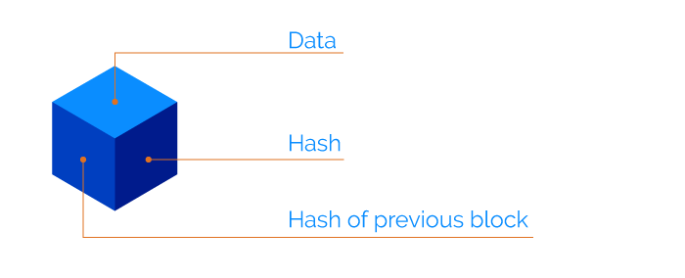
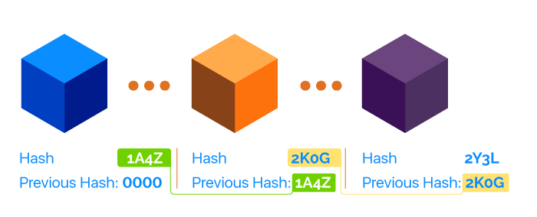
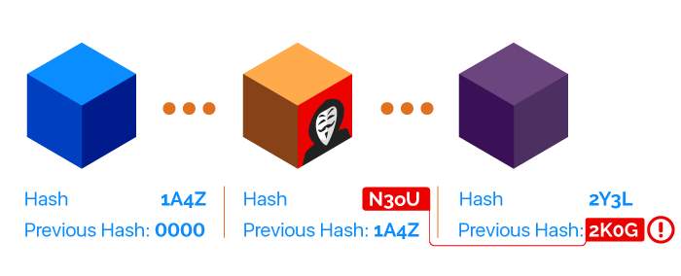
Blockchain
A series of encrypted blocks and given a hash value
64 characters hash, so you can always verify if the block has been changed
You cannot create the block from the hash (one-way)
that are chained together, the hash value of the link is based on the previous hash of the previous block.
If a block is changed it means the hash of that block is different and therefore the next block does not recognise the pervious block as being in the chain.
Also has a time stamp, making had to change
Notes:
https://rubygarage.org/blog/how-blockchain-works

Slide 27
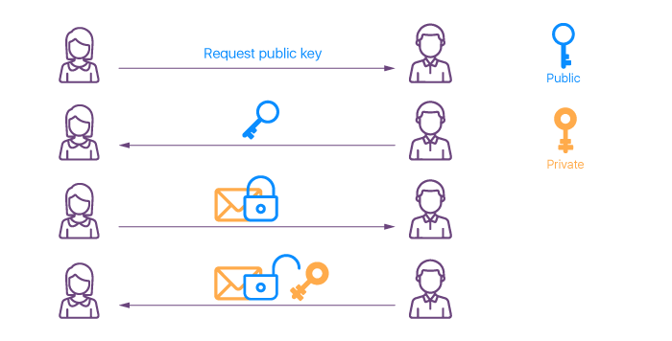
Blockchain
We can use public-key cryptography to transfer money.
A public key acts like an address on the blockchain.
A private key gives its owner access to their digital assets.
Effective security only requires keeping the private key private.
A wallet generates paired public and private keys.
Toe receive funds you give you wallet public key to the person give you the money, you access with the money.
Notes:
the public key can be openly distributed without compromising security.

Slide 28
Blockchain:- Consensus
No central organisation therefore there needs to be a consensus to maintain and verify transactions on the ledger
This is undertaken on a distributed system in which parties do not have to trust each other.
All validated changes are sent to all nodes on the network
Anyone on the network can perform this validation exercise
Bitcoin uses a proof of work algorithm for validation (miners)
Ethereum uses Proof of Stake, less energy consumption

Slide 29
Digital Currencies

Slide 30
Digital Currencies
Digital currencies is a term that refers to all types monetary asset in digital form
If regulated it can be denominated to a sovereign currency - a country’s central bank issuing a digital form of it fat currency
If unregulated it is a virtual currency, crypto currencies fit into this category
European Central Bank (ECB) in 2012 defined virtual currency to classify types of “digital money in an unregulated environment, issued and controlled by its developers and used as a payment method among members of a specific virtual community,”

Slide 31
Virtual Currencies
Virtual currencies are electronic representation of monitory value
That are normally issued, managed and controlled by private issuers
Private issuers may be the developers of the platform or the founding organisation,
Relies on trust, therefor there is no issuing central authority (central bank or regulator)
Their value is based on an underlying mechanism (mining or underlying assets)
Restricted in it use to members of a specific online community or virtual group
Used in peer-to peer payments, increasing being used to purchase goods or services

Slide 32
Crypto
Part of the Virtual currency group
Used cryptography technology to
keep the transactions secure and authentic,
also helps to manage and control the creation of new currency units.
exist and are transacted over distributed ledgers typically on a dedicated blockchain based networks, that serves as a public financial transaction database
Normally open to the common public.

Slide 33
History
Ecash was the first proposed anonymous cryptographic electronic money developed by David Chaum
1995-98 implemented as DigiCash used in micropayments in a US bank
Needed user software and designate specific encrypted keys to withdraw notes from a bank before it could be sent to a recipient.
This allowed the digital currency to be untraceable by the issuing bank, the government, or any third party.

Slide 34
History
1995 bit gold an electronic currency system which required users to complete a proof of work function with solutions being cryptographically put together and published.
The first decentralized cryptocurrency, bitcoin, was created in 2009 by pseudonymous developer Satoshi Nakamoto. It used SHA-256, a cryptographic hash function, as its proof-of-work scheme
Aside he was only trying to make digital cash- a decentralized digital cash system
a new electronic cash system that uses a peer-to-peer network to prevent double-spending. It’s completely decentralized with no server or central authority. – Satoshi Nakamoto, 09 January 2009,

Slide 35
Cryptocurrency answer to digital cash
Digital cash needs a payment network with accounts, balances, and transaction.
But also need a way to stop double spending
Normally using a centralize digital authority to provide correct balance
However, if the cash is distributed how can you provide this consensus.
even more so if the system is designed to be decentralised,
If there is any disagreement about a single minor balance the system breaks
Satoshi showed how it could be done
Notes:
double spending: to prevent that one entity spends the same amount twice.

Slide 36
Cryptocurrency
Are records of transitions recorded on a that no one can change without fulfilling specific conditions.
Your bank account, for example.
Cash out results in a transition on your record and if you meet the conditions you won the Cash.
This is verified by the bank ( transactions, accounts and balances).
Every peer has a copy of the ledger with a complete history of the transactions and hence the balance for every account on the system.
Bob gives X Bitcoin to Alice“ and is signed by Bob‘s private key.
Signed using basic public key cryptography
Using p2p-technology the transaction is broadcast across the network

Slide 37
Cryptocurrency
While the transaction is immediately known across the network it is not confirmed straightaway. – Key concepts
While waiting for confirmation there is a possibility of being forged.
Once confirmed it is immutable
Only ‘Validator’ can confirm a transaction
Once a ‘Validator’ has confirmed it is then added to the distributed ledger.
Validator also gets a reward for undertaking the mining process.
Anyone on the network can be a Validator, so how do we stop one Validator abusing the systems?
We make them work for it. Proof of work - see next sessions on Bit Coin

Slide 38
cryptocurrency
According to Jan Lansky, a cryptocurrency is a system that meets six conditions:^{[18]}
The system does not require a central authority, its state is maintained through distributed consensus.
The system keeps an overview of cryptocurrency units and their ownership.
The system defines whether new cryptocurrency units can be created. If new cryptocurrency units can be created, the system defines the circumstances of their origin and how to determine the ownership of these new units.
Ownership of cryptocurrency units can be proved exclusively cryptographically.
The system allows transactions to be performed in which ownership of the cryptographic units is changed. A transaction statement can only be issued by an entity proving the current ownership of these units.
If two different instructions for changing the ownership of the same cryptographic units are simultaneously entered, the system performs at most one of them.
Notes:
Lansky, Jan (January 2018). "Possible State Approaches to Cryptocurrencies". Journal of Systems Integration. 9/1: 19–31. doi:10.20470/jsi.v9i1.335.

Slide 39
Cryptocurrencies - properties
Bitcoin uses a decentralized network of peers which keep a consensus about accounts and balances.
Compared to your bank account which can be changed by people you don‘t see and by rules you don‘t know.
Cryptocurrencies are entries about tokens in decentralized consensus-ledger/databases.
The consensus-keeping process is secured by strong cryptography.
Not secured by people or by trust, but by by strong cryptography.
Describing the properties of cryptocurrencies we need to separate between transactional and monetary properties.
While most cryptocurrencies share a common set of properties, they are not all the same.
Notes:
It is more probable that an asteroid falls on your house than that a bitcoin address is compromised.

Slide 40
Cryptocurrencies:- Transactional properties
Irreversible: After confirmation, a transaction it cannot be reversed -immutable. Also means no help, if you sent your funds incorrectly or you are hacked, no safety net.
Pseudonymous: Neither the transactions nor the accounts are connected to real-world identities. You can analyse the transaction flow, it is difficult to connect the real world identity of users with those addresses.
Fast and global: Transaction are propagated nearly instantly in the network and are confirmed in a couple of minutes. So location/distance of sender/receiver is irrelevant.
Secure: Cryptocurrency funds are locked using a public key cryptography system. Only the owner of the private key can send cryptocurrency.
Permissionless: It is software based, so once installed, you can receive and send cryptocurrencies. There is no gatekeeper.

Slide 41
Cryptocurrencies:-Monetary properties
Controlled supply:
Most cryptocurrencies limit the supply of the tokens.
All cryptocurrencies control the supply of the token by a schedule written in the code.
No debt but bearer:
The Fiat-money is a system of IOU.
Cryptocurrencies are just representing themselves.
Notes:
he Fiat-money on your bank account is created by debt, and the numbers, you see on your ledger represent nothing but debts. It‘s a system of IOU. Cryptocurrencies don‘t represent debts. They just represent themselves. They are money as hard as coins of gold.

Slide 42
Cryptocurrencies:- Market
See https://coinmarketcap.com/
There is a market for buying and sell Cryptocurrencies

Slide 43
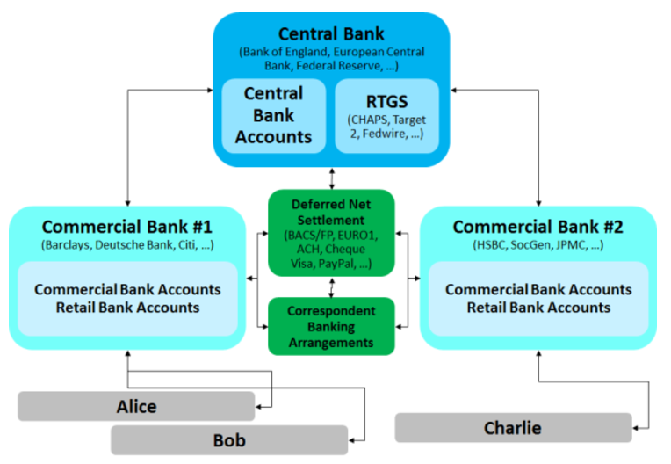
How traditional markets work

Slide 44
Advantages of Cryptocurrencies
Cross border transitions
Traditionally - highly secure private ledgers with a complex process, much faster than it use to be but still takes time.
Blockchain – financial institutions can create a direct link between parties.
Corda from accord’ (agreement) and ‘cord’ (the straightest line between two points in a circle).
Corda - made up of banks who would use a shared ledger for transactions, contracts and important documents
Even competing financial institutions could use a distributed ledger to keep track of the execution, clearing and settlement of transactions without the need to involve any central system
the banks will be able to formalize and secure digital relationships between themselves in ways they could not before and also in a shorter time

Slide 45
Concerns
There are concerns that these can be used as tool for anonymous criminal activity
Transactions are independent from formal banking systems –undermining the central banks ability to control monetary policy, secure from political influence.
Cryptocurrencies are limited and therefore central banks cannot control inflation by printing or restricting money.
Exchange of cryptocurrencies are complex and hard to track- fast method of payment worldwide
cryptocurrencies offer anonymity –use in the black market economy
evade tax and money laundering

Slide 46
Theft and fraud of cryptocurrencies.
There have been some high profile cases.
As of December 2017, around 980,000 bitcoins have been stolen from cryptocurrency exchanges.
Also illegal markets had bitcoins stolen
When this happens very often the exchange has to close
this is a nascent industry and as such the infrastructure is not as well design as that of banks
As a results there is not the regulatory oversight
Lack of consumer protection against loss or theft.
Notes:
One type of theft involves a third party accessing the private key to a victim's bitcoin address, or of an online wallet. If the private key is stolen, all the bitcoins from the compromised address can be transferred. In that case, the network does not have any provisions to identify the thief, block further transactions of those stolen bitcoins, or return them to the legitimate owner.

Slide 47
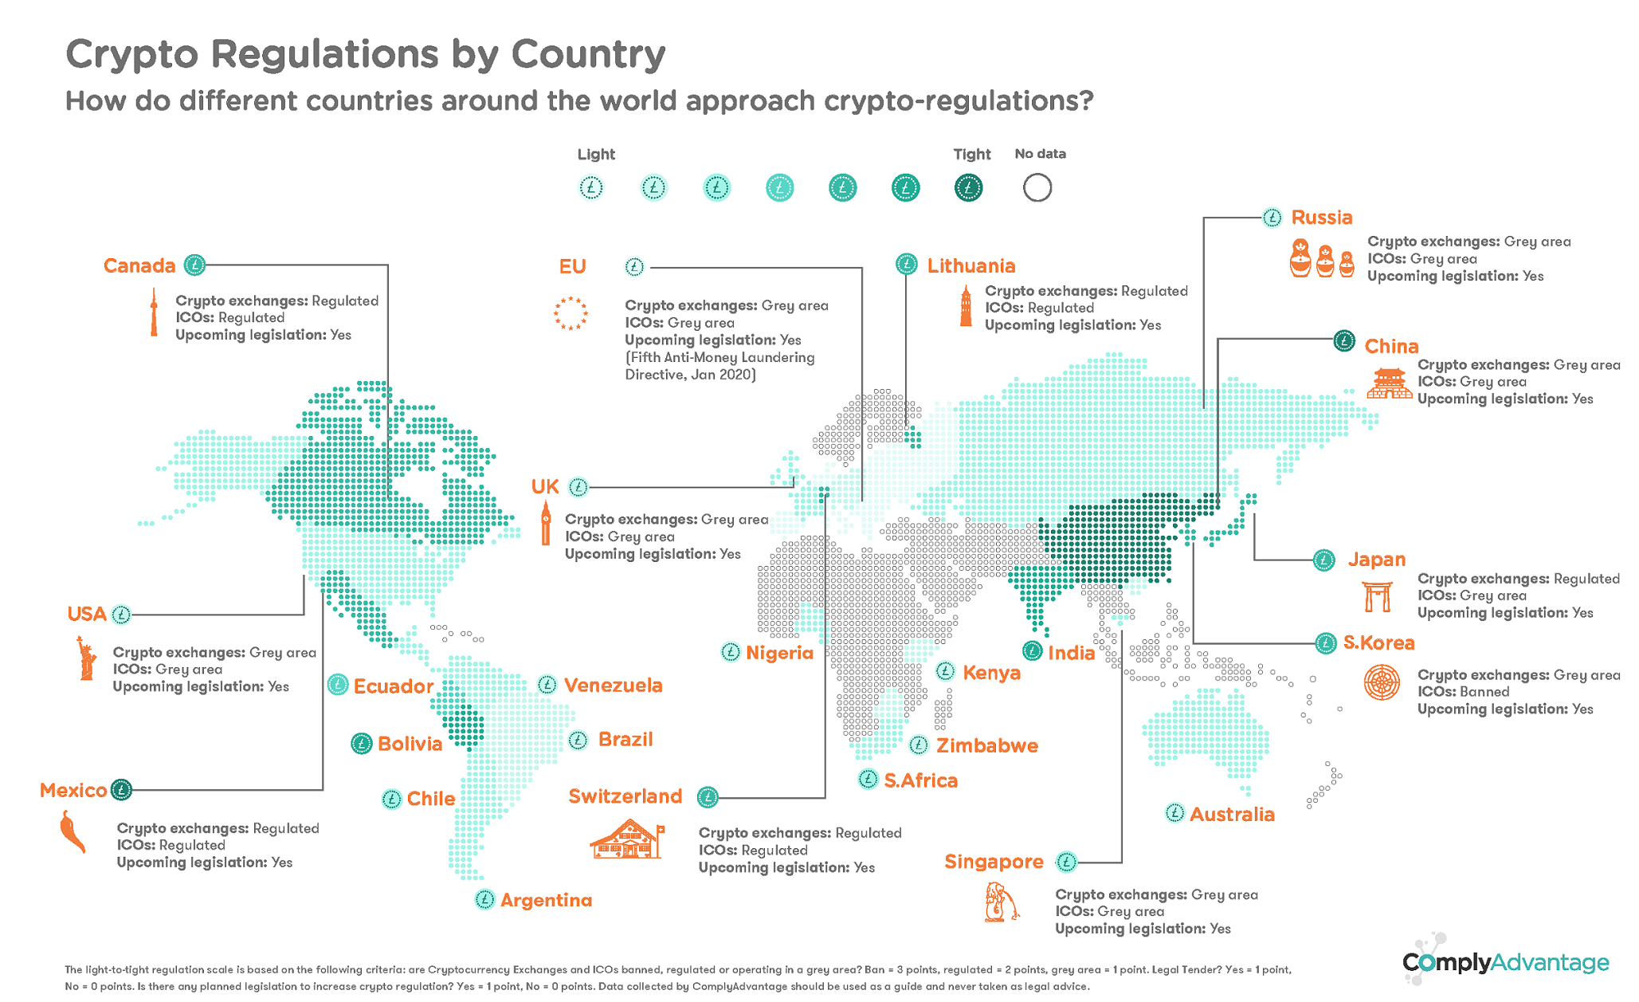
Notes:
https://complyadvantage.com/blog/cryptocurrency-regulations-around-world/

Slide 48
Example: A simple currency
Owner can create coins
Owner spends coin
George spends coin
Double Spend
Signed by PK_{George}
Jane now owns the coin
Signed by PK_{George}
George spends the coin again
Pay to PK_{jane} : H( )
Pay to PK_{Bill} : H( )
Signed by PK_{owner}
George now owns the coin
Pay to PK_{George} : H( )
Signed by PK_{owner}
All new coins belong to the owner
CreateCoin [uniqeCoinID]

Slide 49
A simple Cryptocurrency
We know that if chain these together we can stop the double spend problem- Everyone can see the history of transactions
Everyone can see when coins are spent
H ( )
Pervious H( )
Pervious H( )
Pervious H( )
TransID 56
TransID 57
TransID 58
Transaction(s)
Transaction(s)
Transaction(s)
Notes:
Allows us to detect current spending

Slide 50
A simple Cryptocurrency
In a block there may be a number of transitions.
Every coin has an ID
Transactions : Create multiple coins
Send to the PK address of the recipient
Valid as the owner says so (in this simple system that is te rule)
TransID: 58 Type: CreateCoins
Coins created
number | value | Recipient’s PK
0 | 4.0 | Ox……….
1 | 1.5 | Ox……….
2 | 6.2 | Ox……….
CoinID 58 (0)
CoinID 58 (1)
CoinID 58 (2)

Slide 51
A simple Cryptocurrency
PayCoins transition
will consumes (and destroys) some coins.
create new coins of the same total value
If valid then the transaction will be written into the blockchain
TransID: 59 Type: PayCoins:
Consumed coinIDs : 23 (1), 46 (0), 53 (3)
Coins created
number | value | Recipient’s PK
O | 4.0 | Ox……….
1 | 1.5 | Ox……….
2 | 6.2 | Ox……….
Signatures
Valid if
Consume coins are valid
Not already consumed
Total value out = total value in
and
Signed by owners of all consumed coins

Slide 52
A simple Cryptocurrency
Coins are immutable
Never changed, or sub-divided, not combined
Only created once in one transaction and later consumed in another transaction
You get the same effect as sub-diving by using transaction
To subdivide: create new transactions
Consume coins
Pay out new two coins to yourself of the same total value
Similarly you can combine coins and pay on a coin by creating a chain of transitions each of which pass that value on in the form of a new coin.

Slide 53
A simple Cryptocurrency
This works as people can see which coins are valid, see the history and the valid transactions to stop double spending.
However, we need to remove the need for a central ‘owner’ – trusted partner, signing all the transactions.
Does all the of the simple cryptocurrency does.
In a decentralised way so one particular part is trusted.
Agree on a history
Design a validation method
Assign ID in a decentralised way

Slide 54
Summary
In this session we have explored the development of currencies.
The need to replace bartering
The shortfalls of a fait currencies
How central banks enforce monetary policy
The development of cryptocurrencies
How they do not need a central bank and layers of logical protection
The need for confirmation and how that process is rewarded.
Some of the concerns – lack of control, illegal activity and security

